Slide 1
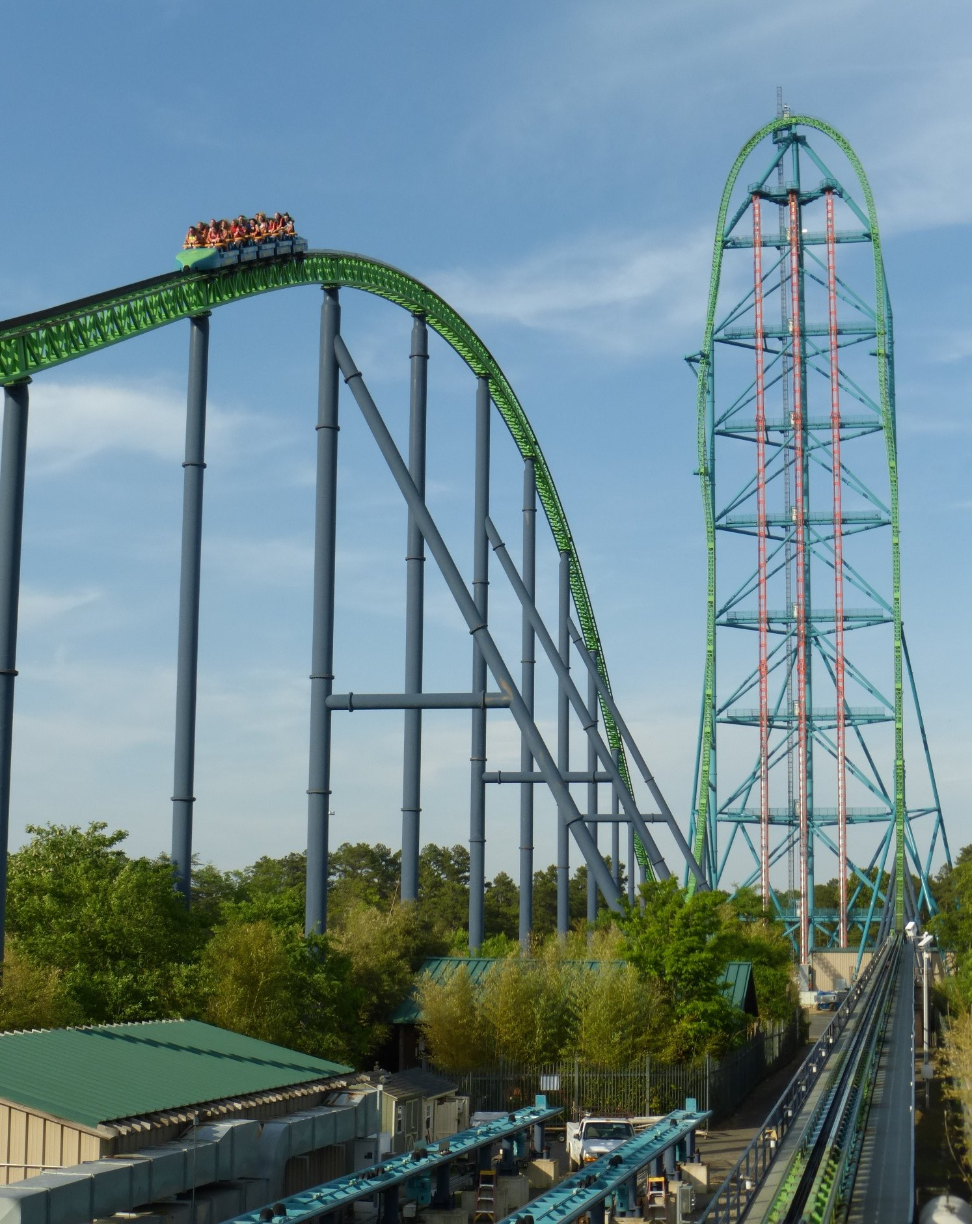
Kingda Ka
By: Darren George and Noah McDermott
Kingda Ka Photo [2]

Slide 2
Objective
To accurately model the line at Kingda Ka, the world's fastest roller coaster [2]
By accurately modeling the line, we can identify important performance metrics
This information is very important to Six Flags as:
The company needs to know how long the line will be to accommodate customers waiting in line
The company needs all the information possible to find ways to drive revenue, knowing the amount of people in line can be very useful

Slide 3
Important Performance Metrics
Average time a person spends in the queue
Maximum time a person spends in the queue
Maximum amount of people waiting in the queue throughout the day

Slide 4
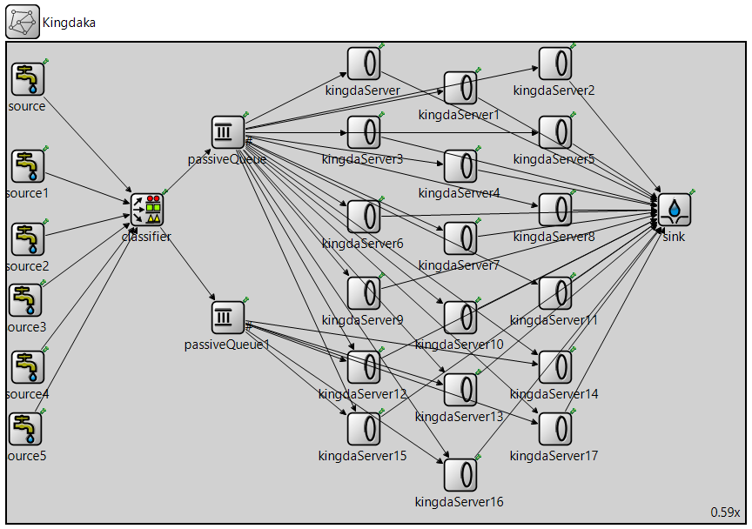
System Block Diagram
Each pair of sources correspond to certain time periods throughout the day
The classifier allows “passiveQueue1” to be the priority queue as this is the fast pass customers
Each “kingdaServer” represents a seat on the ride, and “kingdaServer12” to “kingdaServer17” are the front 6 seats which are priority for fast pass users [2]

Slide 5
Original vs Alternate Design- different time intervals
3 pairs of 2 sources (one for regular pass, one for fast pass) for a total of 6 sources
ORIGINAL DESIGN
First two sources operate from 10:30 am to 3 pm
Middle two sources operate from 3 pm to 6 pm
Last two sources operate from 6 pm to 9 pm
ALTERNATE DESIGN
First two sources operate from 10:30 am to 9 pm (10.5 hours)
Middle two sources operate from 11:30 pm to 6:00 pm (6.5 hours)
Last two sources operate from 12:30 pm to 3:30 pm (3 hours)
Each source has an exponential arrival time, and during busier times of the day multiple pairs of sources can be running at the same time

Slide 6
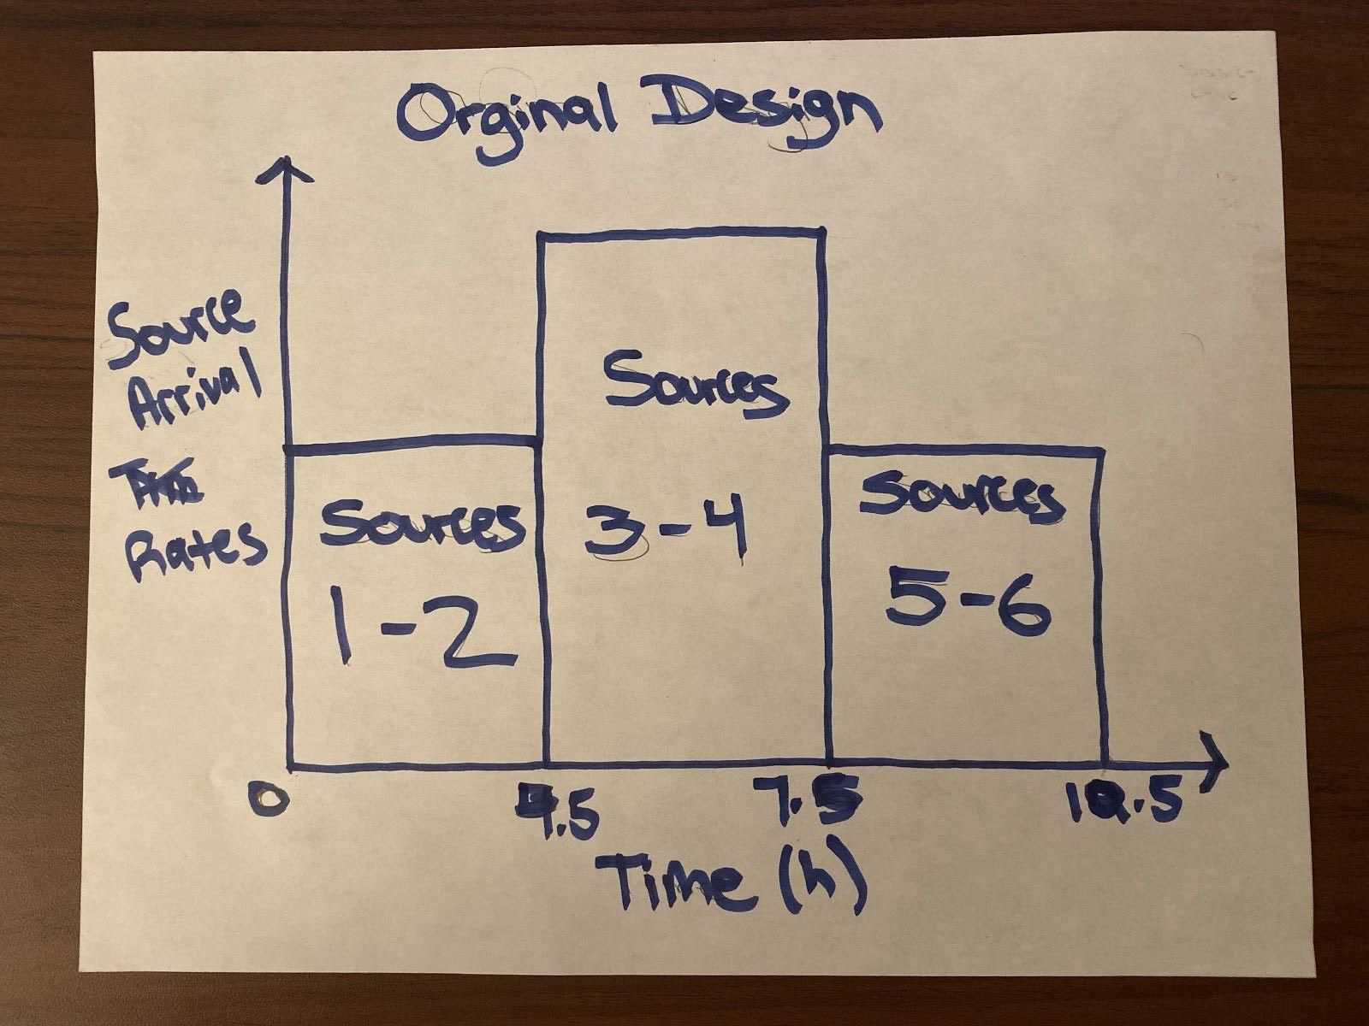
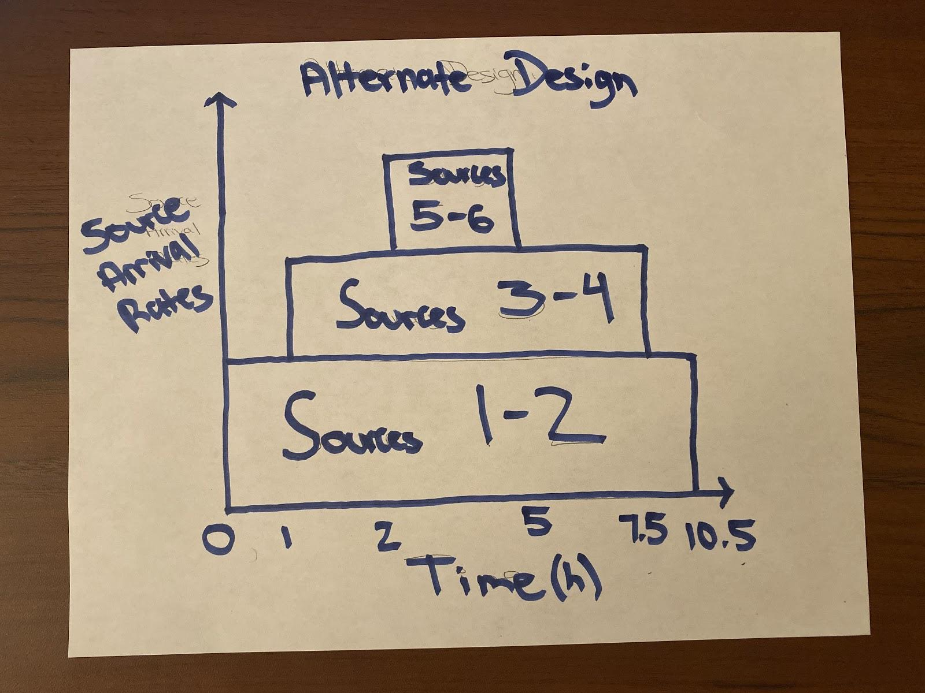
Why our alternate design is superior to our original design
Alternative design is better because it provides a more gradual increase and decrease in arrival rates and better models the actual queue increase of the ride

Slide 7
Mathematical Model Variables- Queues
2 passive queues with a classifier that favors the fast pass customers (“passiveQueue” is the regular line, “passiveQueue1” is the fast pass line)
The classifier sends the priority packet (fast pass) down to the bottom queue, and sends the non-priority packet up to the passiveQueue, however, if the top queue still has packets while the bottom queue doesn’t, the regular packets can be assigned to the bottom 6 servers [2]

Slide 8
Mathematical Model Variables- Servers
18 servers that represents each seat of the Kingda Ka ride [3]
All 18 seats can be occupied by regular customers, but the bottom 6 seats are designated when fast pass customers arrive [2]
We got the servers to send packets to the sink every 0.771 min, this was computed from the following
1,400 customers can ride per hour = 23.333 customers can ride per min [3]
18 seats per ride, so 23.333 / 18 gives us 1.296 rides per min, and the reciprocal (1/ 1.296 rides per min) gets us 0.771 min between each ride

Slide 9
Mathematical Model Variables- Sources
Each regular customer source has an exponential arrival time because the arrival of customers is a random, independent, process with a constant average rate (although the rate changes during the day)
Each fast pass customer source has a deterministic arrival time because the fastpass system is a limited supply of tickets that allows fast pass users to pick times to enter a ride, and for Kingda Ka a max of 6 fast pass users can enter per ride [2]
The only information we could find to help us assign values to the sources was that the average queue time is 1 hour and the maximum queue time is 2 hours [1]. With this information we had to guess and check source values to fit the model.

Slide 10
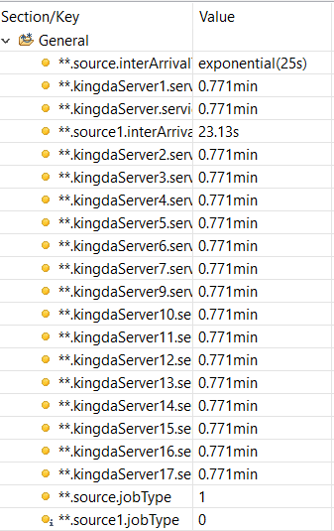

Mathematical Model Variables- ini File

Slide 11
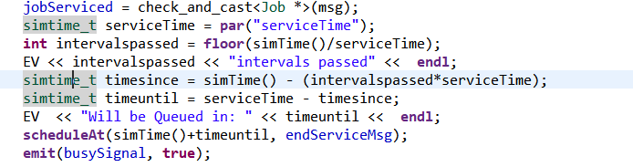

Code
Custom server block based on Server.cc
Original server schedules events at the current time plus the service time
KingdaServer schedules events at the next multiple of the service time
Example: If the service time is 4 seconds and a packet arrives at 10.56 seconds, it will be scheduled at 12 seconds
Server.cc
KingaServer.cc

Slide 12
OMNetPP Model

Slide 13

OMNetPP Model in Simulation

Slide 14
Results
Run | Average Queue Time (s) | Maximum Queue Time (s) | Max Queue Length (amount of people)
1 | 3775 | 6939 | 2097
2 | 3800 | 7208 | 2152
3 | 3752 | 7005 | 2085
4 | 3690 | 7115 | 2110
5 | 3707 | 6997 | 2117
ACTUAL | 3600 [1] | 7200 [1] | N/A

Slide 15
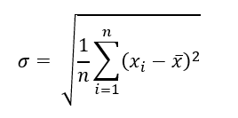


Accuracy of Results
Average Queue Time
Mean: 3744.8s
St. Dev: 41.09s
95% CI: (3693.78, 3795.82)
99%CI: (3660.20, 3829.41)
STD Error: 18.37
Actual value: 3600s [1]
Maximum Queue Time
Mean: 7052.8s
St. Dev: 96.23s
95% CI: (6933.32, 7172.29)
99%CI: (6854.66, 7250.94)
STD Err: 43.03
Actual value: 7200s [1]
Maximum Queue Length
Mean: 2112 people
St. Dev: 23 people
95% CI: (2083, 2141)
99%CI: (2065, 2159)
STD Err: 10.17

Slide 16
Accuracy of Results- Percent Error
Average Queue Time:
Actual average queue time: 3600s [1]
Experimental found average queue time: 3744.8s
% error = (abs (actual - exp) / actual) * 100%
% error = 4.02%
Max Queue Time:
Actual max queue time: 7200s [1]
Experimental found max queue time: 7052.8s
% error = (abs (actual - exp) / actual) * 100%
% error = 2.04%

Slide 17
Conclusion
Using information found online for Kingda Ka, we were able to successfully generate source arrive times that model the ride in OMNetPP
Some ways to improve the model would be
Using more sources to divide the arrival rates throughout the day to create a more accurate model
Conduct more simulation runs to get a smaller range of the confidence interval
In the end we were able to create the model and find that the max length of the queue for Kingda Ka with a 99% confidence interval is 2059 to 2161 people
With this information, Six Flags can have a better understanding of the layout for the physical queue as people wait for the ride and knowledge about the traffic Kingda Ka creates

Slide 18
References
[1]"Six Flags Great Adventure Strategies", Theme Park Insider, 2019. [Online]. Available: https://www.themeparkinsider.com/news/response.cfm?ID=945509801. [Accessed: 18- Dec- 2019].
[2]"Kingda Ka | Six Flags Great Adventure & Safari", Six Flags Great Adventure & Safari, 2019. [Online]. Available: https://www.sixflags.com/greatadventure/attractions/kingda-ka. [Accessed: 18- Dec- 2019].
[3]"Kingda Ka - Six Flags Great Adventure | Facts Sheet", Ultimaterollercoaster.com, 2004. [Online]. Available: https://www.ultimaterollercoaster.com/themeparks/new05/kingdaka/sfgadv_kingdaka_facts.shtml. [Accessed: 18- Dec- 2019].

